Slide 1
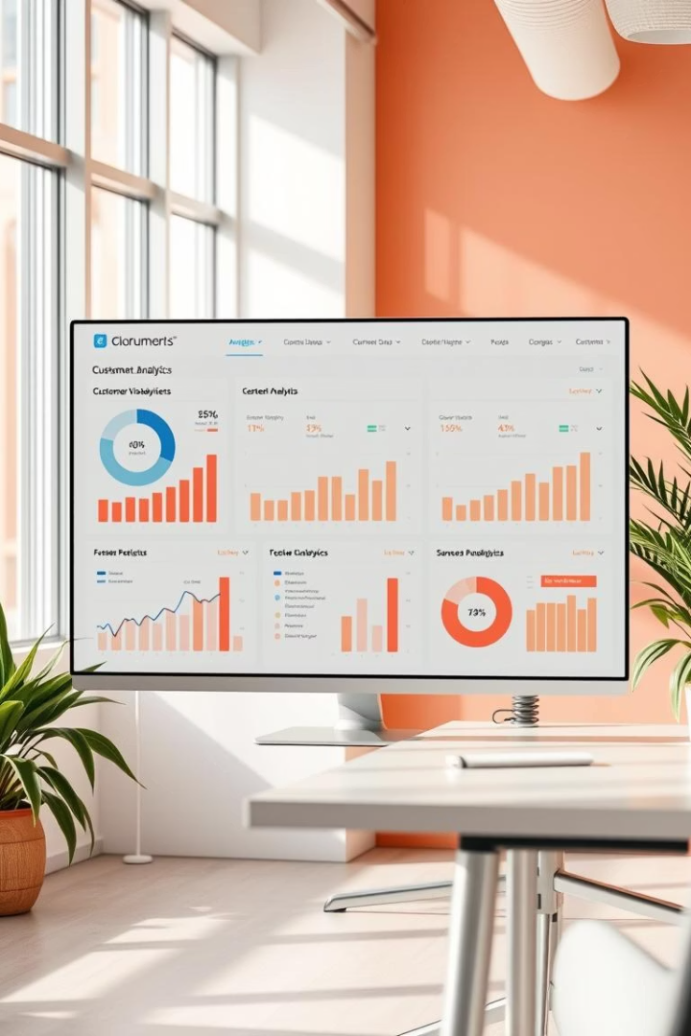
E-Commerce Customer Segmentation and Predictions
This report presents a detailed analysis of customer segmentation using RFM metrics and clustering algorithms actionable business insights.
GM
by Ganesh Malji

Slide 2

Data Summary and Preprocessing
Raw vs Cleaned Data
Issues Resolved
Original dataset - 541,909 rows and 8 columns.
After cleaning, 397,884 rows remained for reliable analysis.
Removed ~25% rows missing CustomerID
Filtered out negative or zero Quantity and UnitPrice
Excluded canceled transactions (InvoiceNo starting with 'C')
Outcome
Clean dataset ensured accuracy and trustworthiness of subsequent analysis.

Slide 3
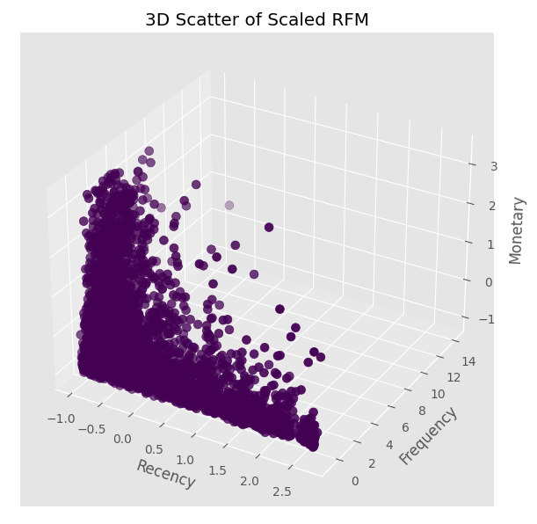
RFM Feature Engineering
Customer Base
RFM Metrics Defined
4,338 unique customers analyzed.
Filtered to 3,911 after removing outliers.
Recency: Days since last purchase
Frequency: Number of purchases
Monetary: Total spending
Distribution Insights
Filtering improved data quality by reducing skewness and outliers in frequency, monetary, and recency distributions.

Slide 4
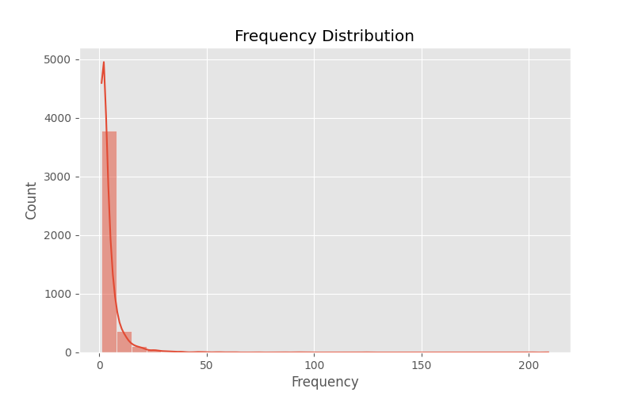
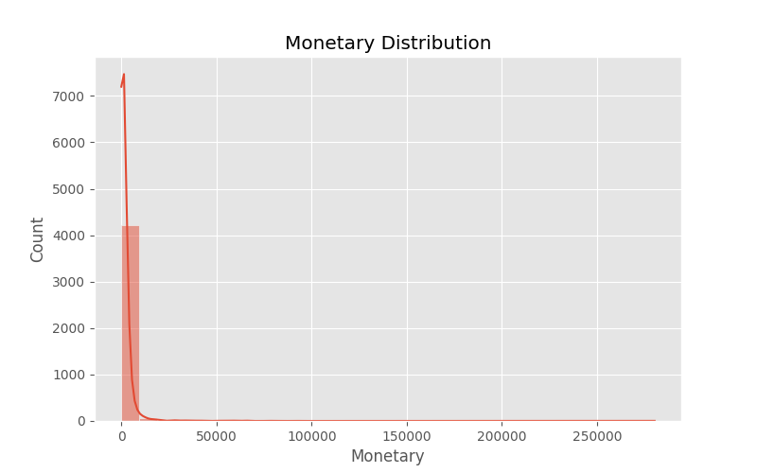
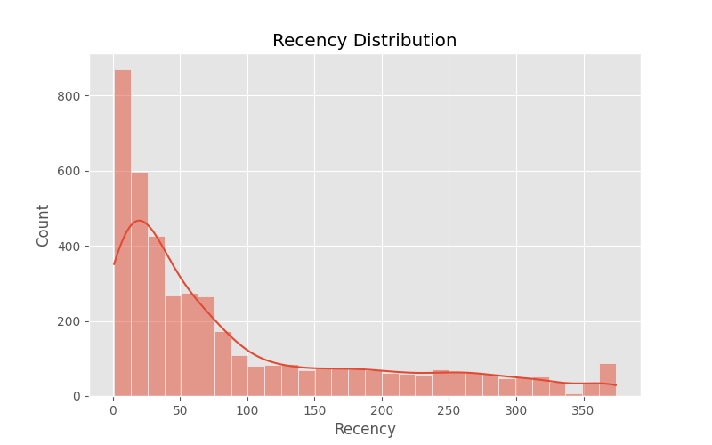
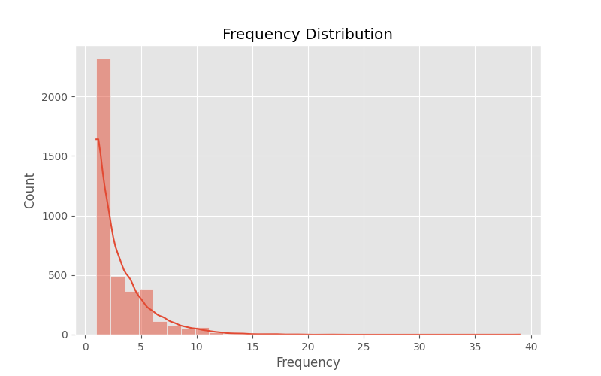
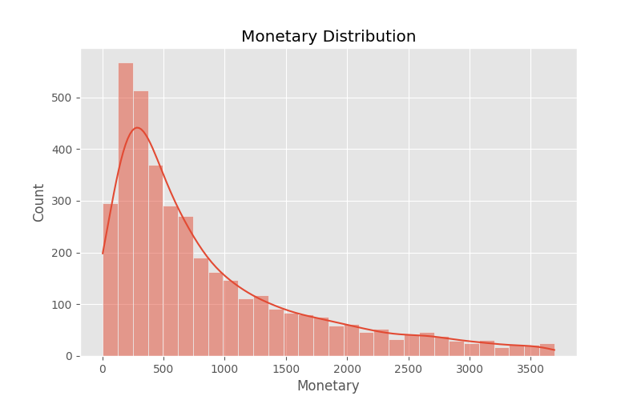
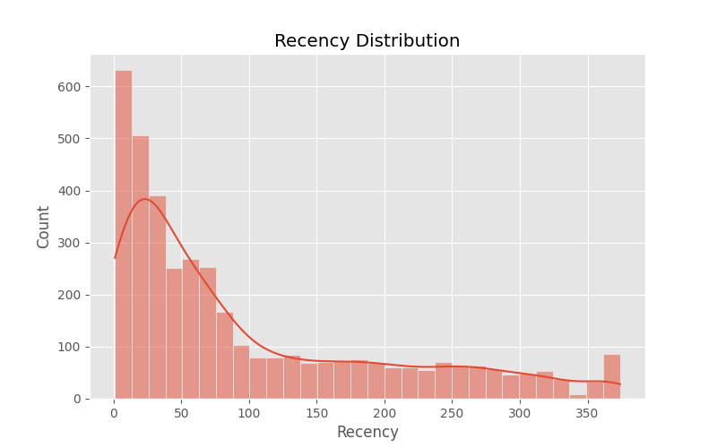
Before and after handling outliers

Slide 5
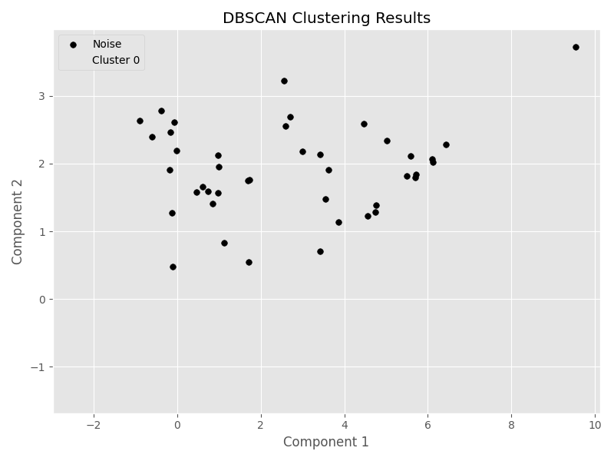
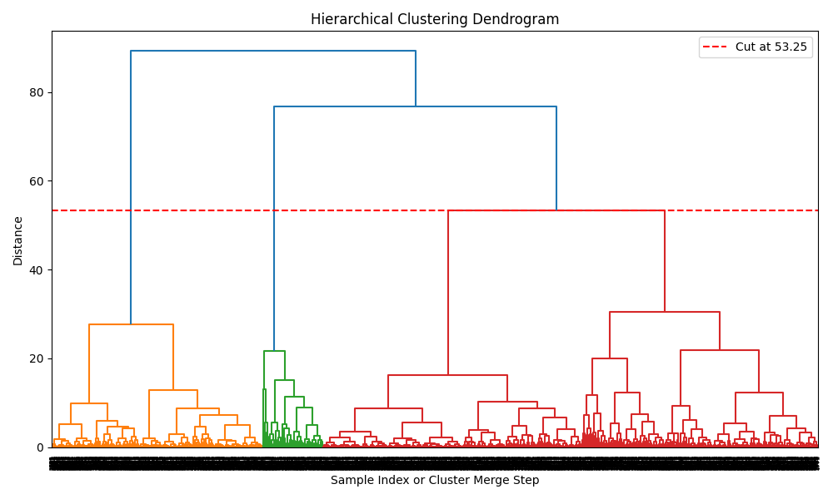
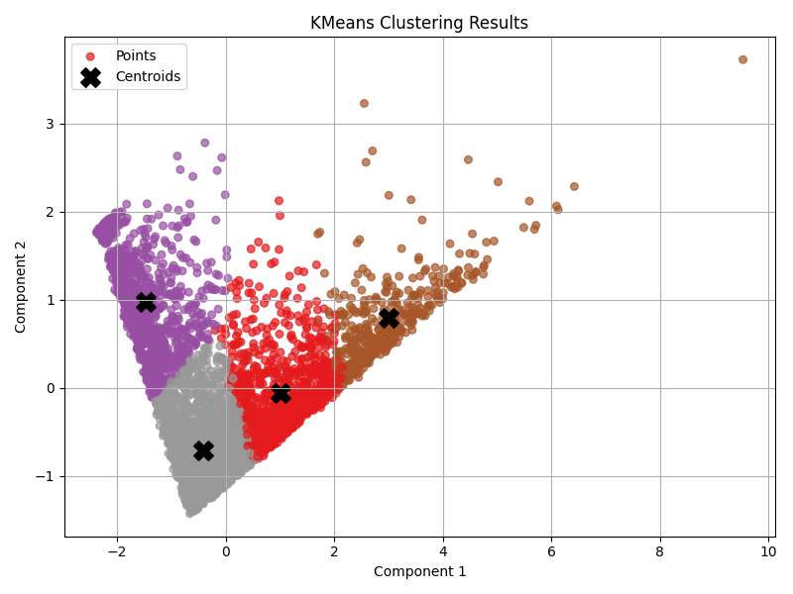
Clustering Results & Interpretation
DBSCAN Clustering
Hierarchical Clustering
KMeans Clustering
Identified 3,869 core customers and 42 outliers. Effective for noise detection but limited cluster variety.
Formed 3 clusters with moderate silhouette score (0.3975). Revealed a large base of moderate customers and smaller premium groups.
Best performance with 4 clusters, silhouette score 0.4255. Clear segmentation into Top Customers, Loyal Regulars, At Risk, and Big Spenders.

Slide 6
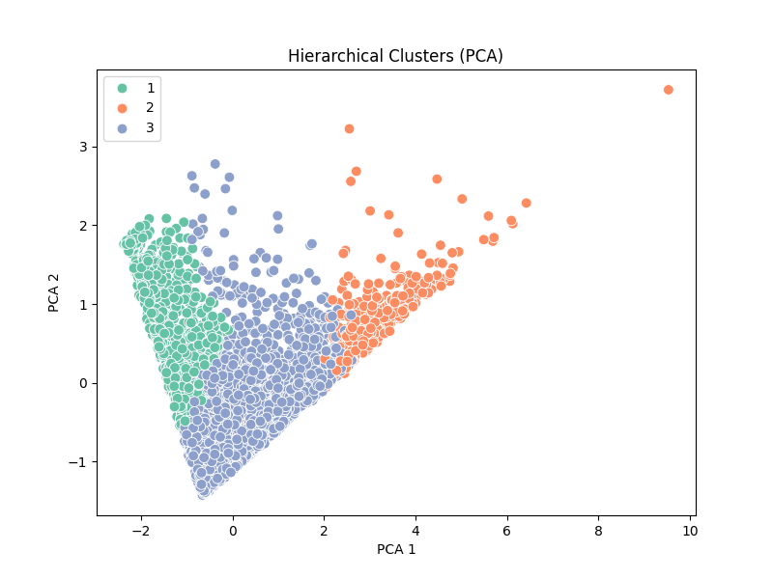
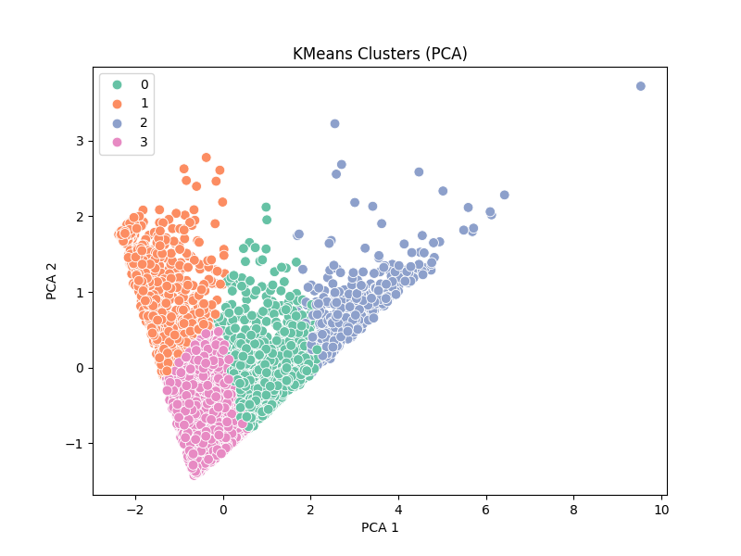
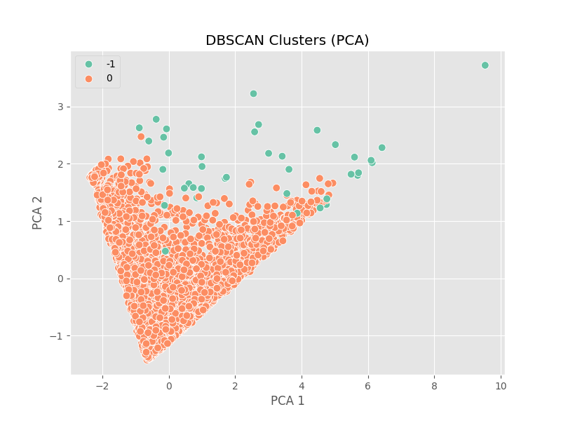
PCA :

Slide 7
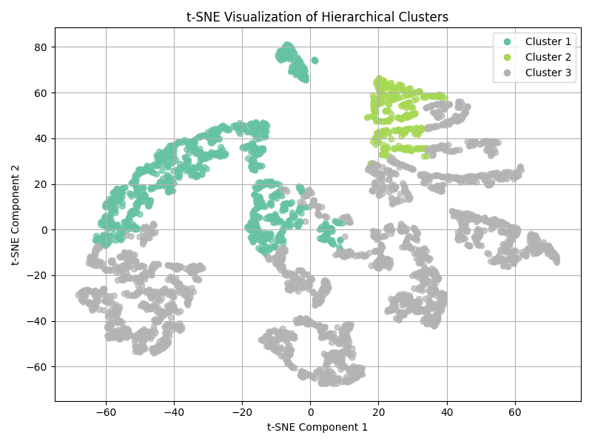
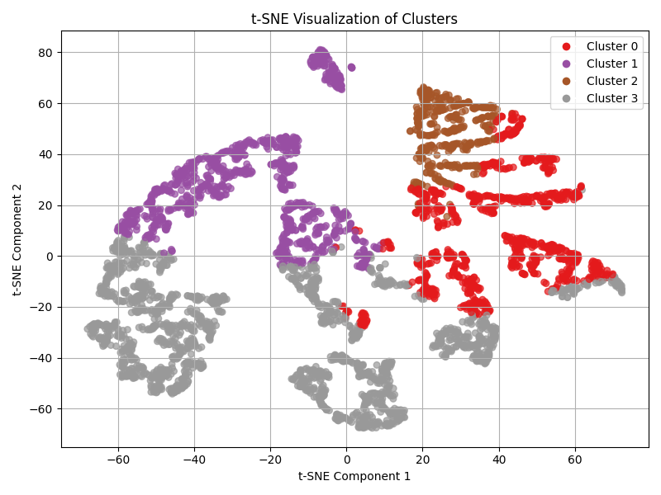
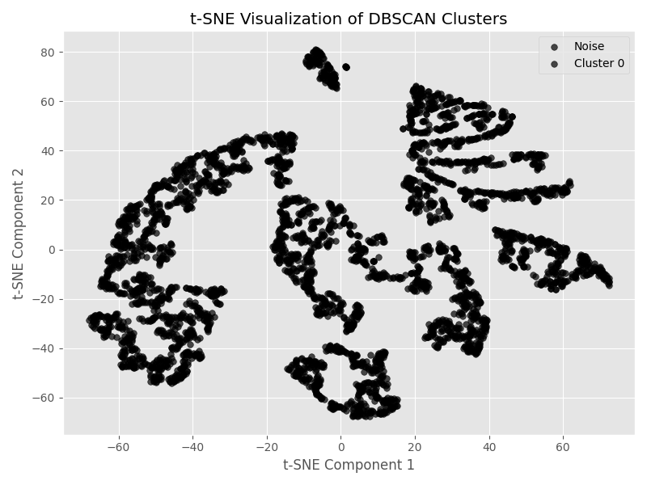

Slide 8
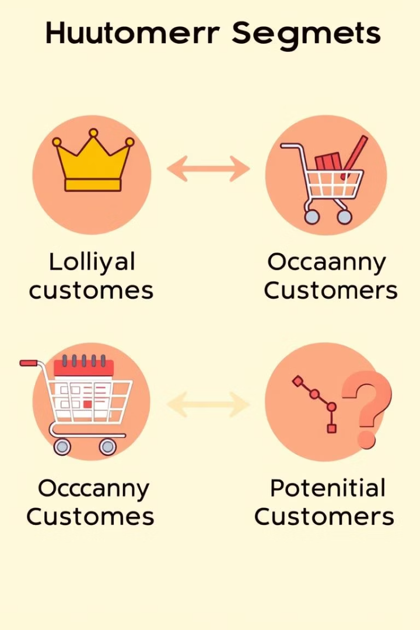
KMeans Cluster Breakdown
Cluster 3: Top Customers
1,669 customers with high frequency, high spend, and recent purchases. Priority for loyalty programs.
Cluster 1: Loyal Regulars
952 customers with good spending and moderate recency. Ideal for personalized offers.
Cluster 0: At Risk
904 inactive customers with low spending. Target for reactivation campaigns.
Cluster 2: Big Spenders
386 customers with high spend but low purchase frequency. Incentivize more regular buying.

Slide 9

Business Insights from Customer Behavior
Segment-Specific Strategies
Top Customers: Focus on retention and loyalty programs
At Risk: Launch reactivation campaigns
Big Spenders: Encourage frequent purchases
Loyal Regulars: Use personalized offers to deepen engagement
RFM Metric Learnings
Many customers have not purchased recently; monetary values are skewed; frequency drops sharply after three purchases.

Slide 10

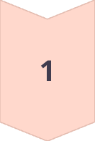
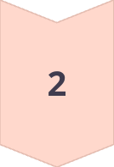
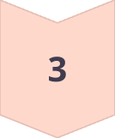
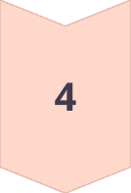
Strategic Recommendations
Retention Programs
Target Clusters 3 and 2 with loyalty and premium segment initiatives.
Targeted Email Campaigns
Engage Clusters 0 and 1 with personalized messaging to boost activity.
Churn Monitoring
Use Recency metric to track and prevent customer loss monthly.
Segment Tracking
Regularly monitor customer segments to adapt strategies dynamically.

Slide 11
Final Artifacts and Conclusion
Data and Models
Conclusion
Cleaned Data: data/cleaned_data.csv
KMeans clustering provided the most meaningful customer segments, enabling targeted marketing and operational strategies to improve business outcomes.
RFM Data: data/rfm_data_filtered.csv
Clustered Data: data/clustered_rfm.csv
Models: KMeans, Hierarchical, DBSCAN saved as .pkl files

